Slide 1
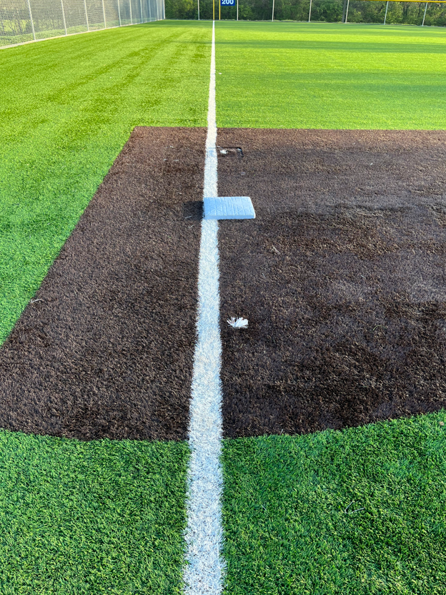
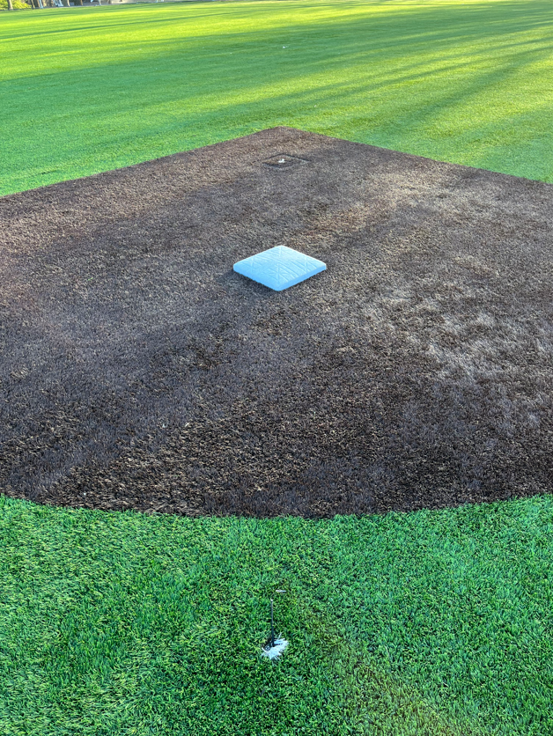
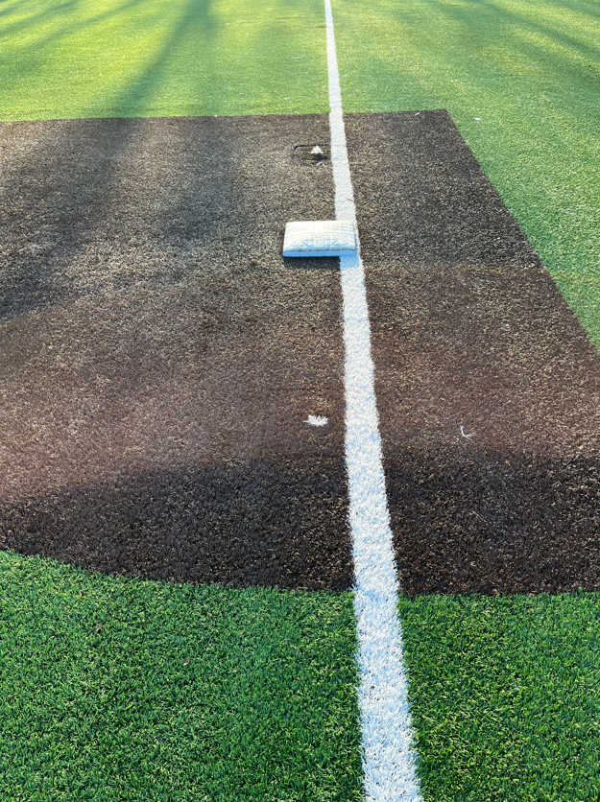
Adjusting the base distances on Crockett fields 5 & 6
3rd base
2nd base
1st base
70’
70’
70’
65’
65’
65’
60’
60’
60’
60’ for 7/8YO baseball & all softball
65’ for 9/10YO baseball
70’ for 11/12YO baseball
When moving the bases, make sure to place the plugs in the unused anchor slots

